Slide 1



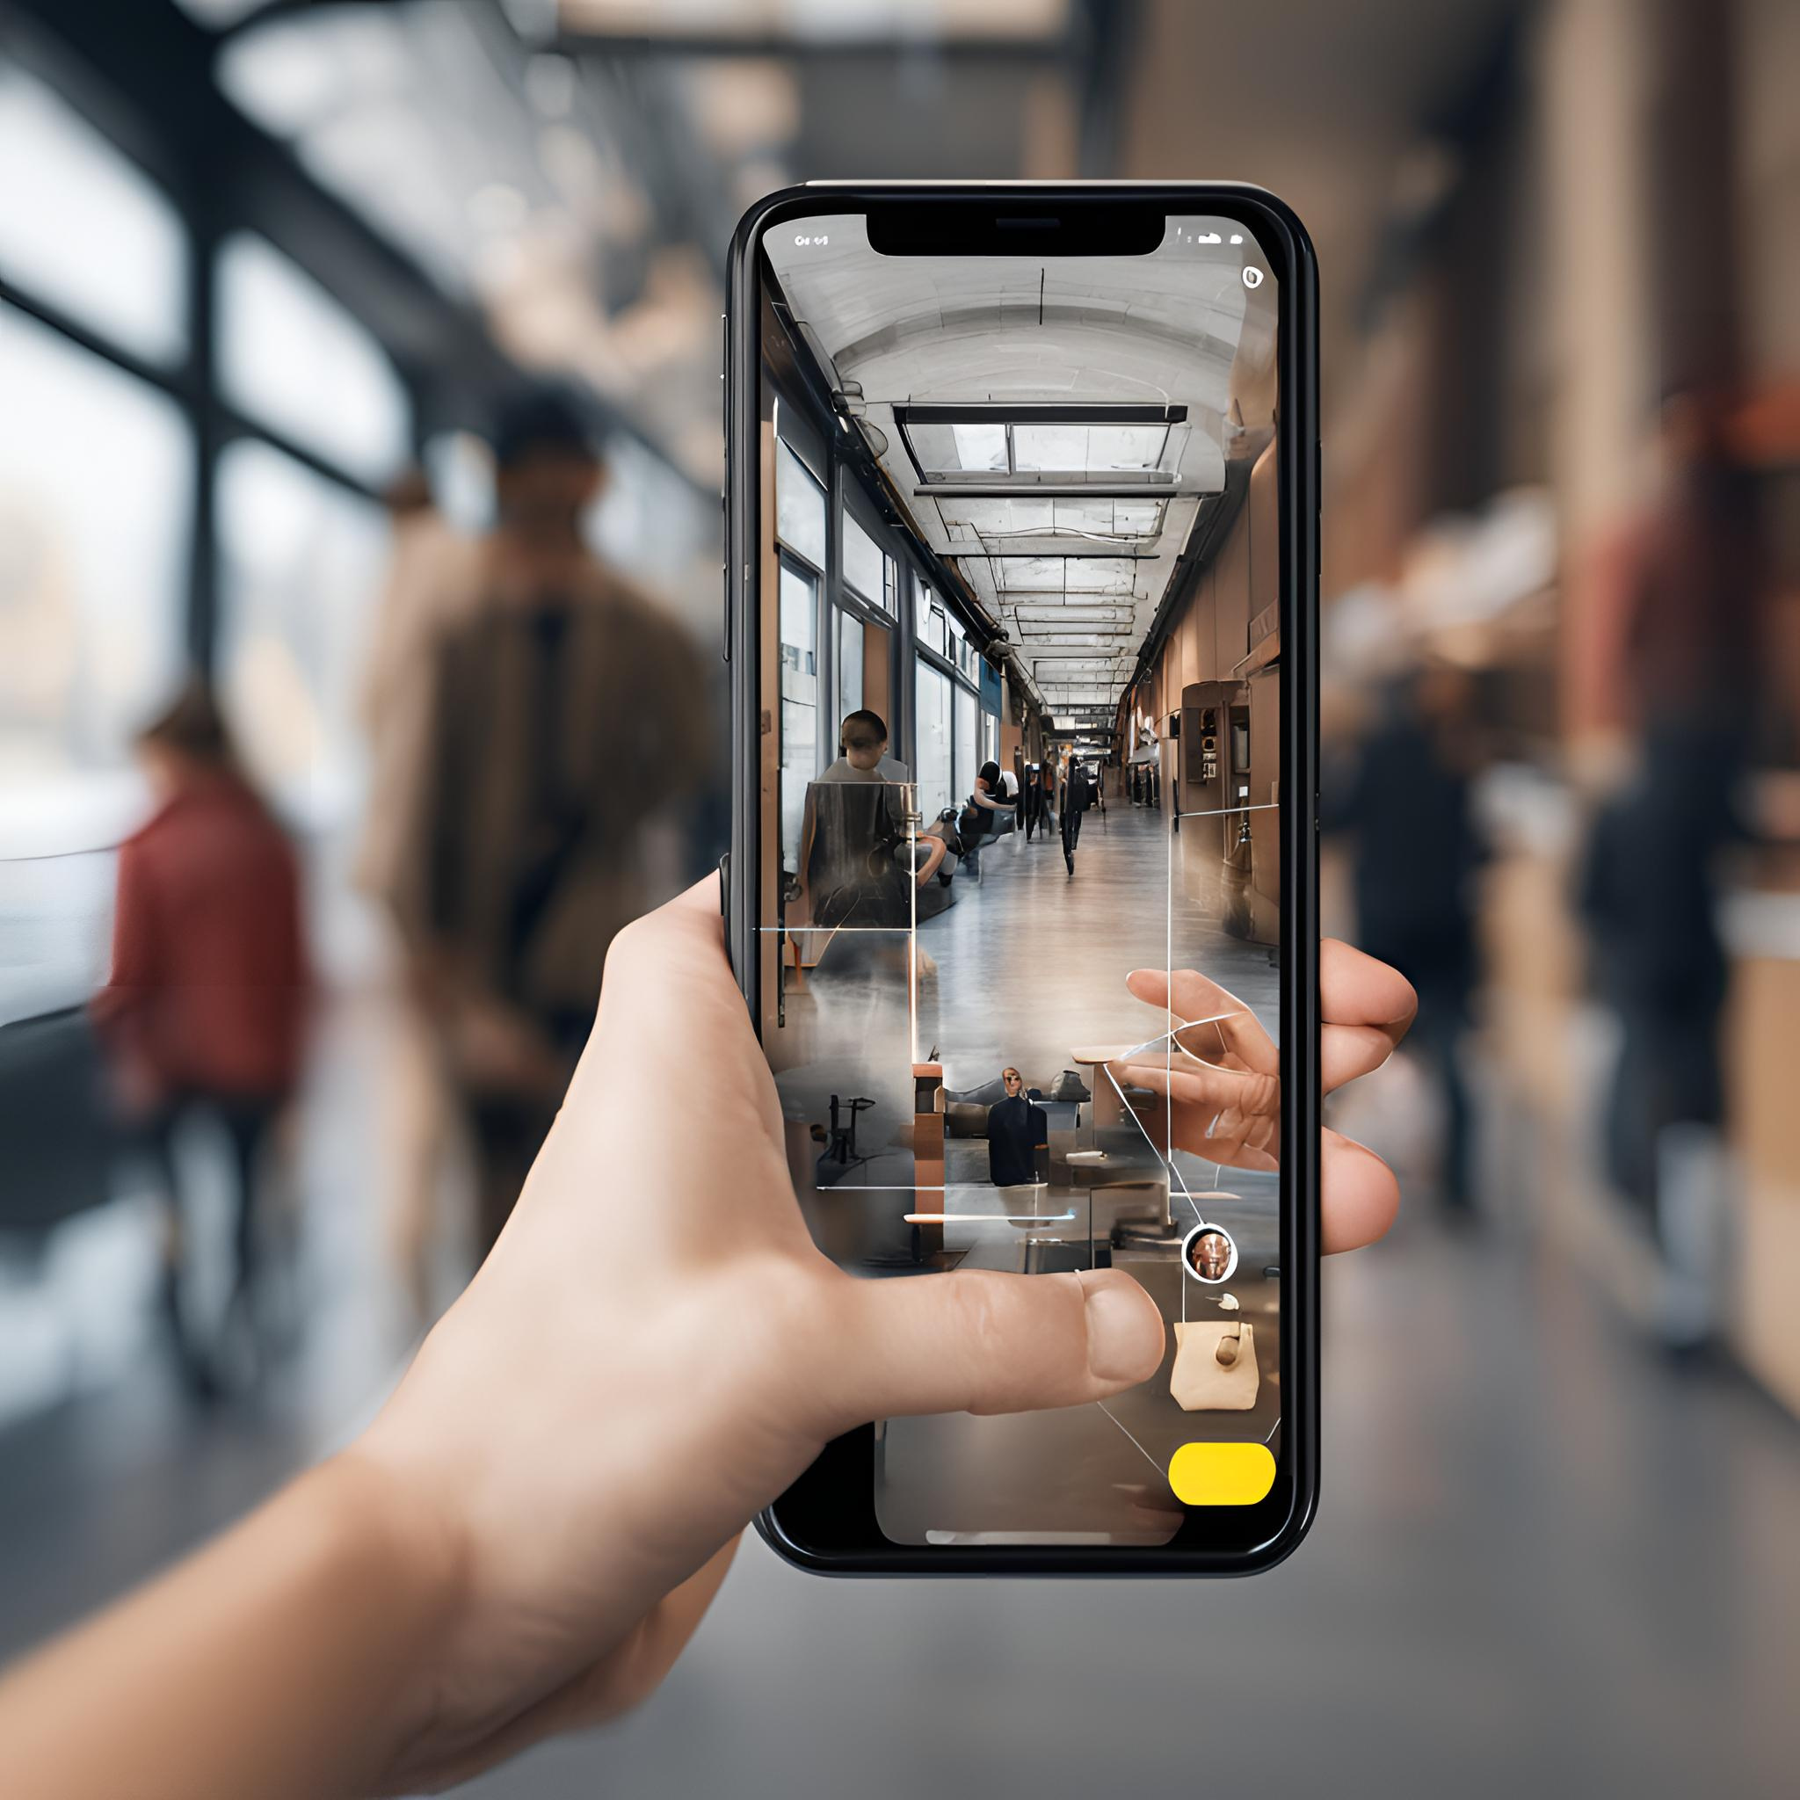
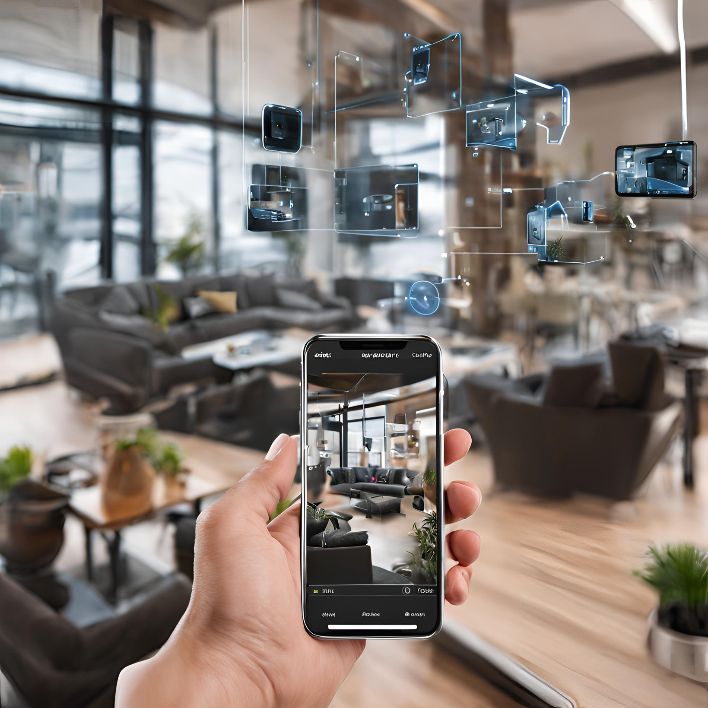
INDOOR OBJECT DETECTION AND RECOGNITION USING TRASNFER LEARNING
COMPUTER SYSTEMS DEPARTMENT
FACULTY OF COMPUTER AND
INFORMATION SCIENCE
AIN SHAMS UNIVERSITY

Slide 2

Under Supervision
Prof. Eman Shaaban
TA. Roqaia Safwat

Slide 3

Team Members
Asmaa Abdelrazek
Batoul Ragaie
Mariam Hassan
Menna Muhammad
Rofaida Sobhy
Zainab Ahmed

Slide 4


01
Problem Description
TABLE OF
02
Objectives
CONTENTS
03
Related Work
04
System Architecture
05
Dataset
06
Functionalities & Implementation Techniques
07
Experimental Results & Demo
08
Conclusion

Slide 5
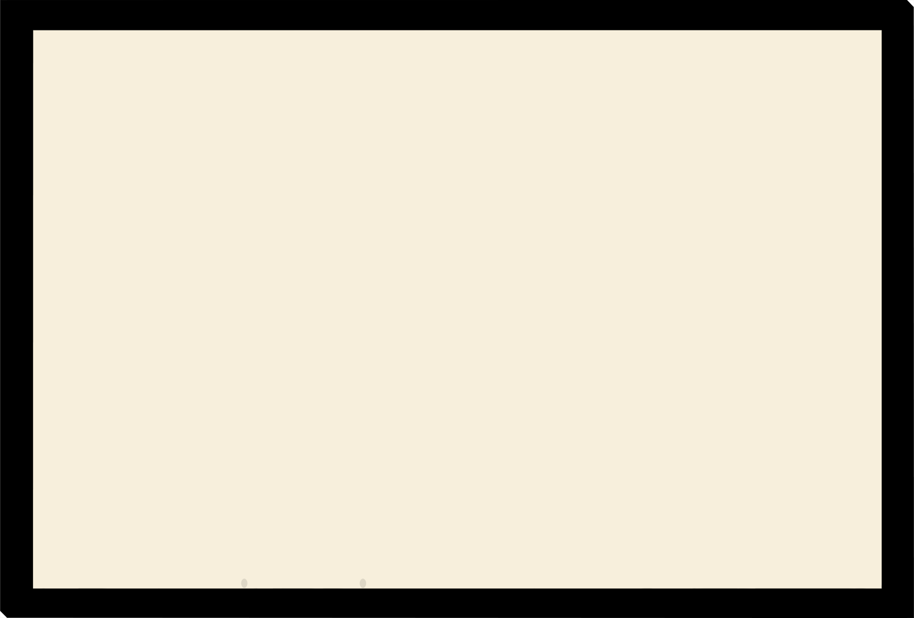

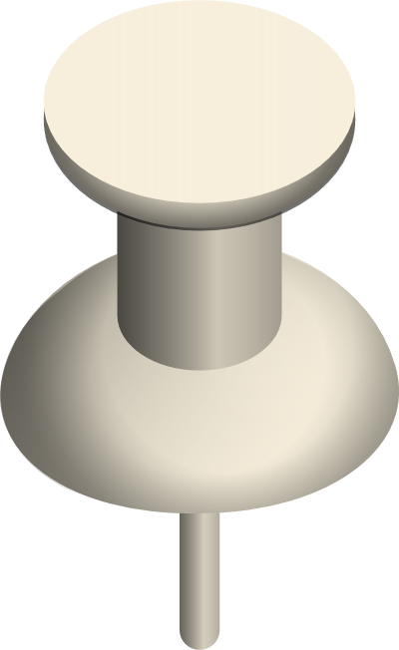


Problem Description
Many people have vision loss due to several reasons. Visually impaired individuals face significant challenges when moving around and interacting within indoor spaces. Traditional tools such as screen readers and white canes provide limited support in identifying objects crucial for independent living and daily tasks.

Slide 6

02
Objectives

Slide 7


Objective
The project focuses on designing an Indoor Object Recognition System for the Visually Impaired, a mobile app that utilizes transfer learning methods to achieve precise and effective object identification.

Slide 8

03
Related Work

Slide 9

Citation | Model | dataset | accuracy
Afif et al. | MobileNet v1, MobileNet v2 and inception v3 | MCIndoor | 99.7%
Shaikhet al. | YOLO v3 | COCO | 85%
ASHIQet al. | MobileNet | ImageNet | 83.3%
Afif et al. | YOLO v3 | Collected dataset | 73.19%
Saidulu et al. | YOLO | COCO | 90%
Related Work

Slide 10
04
System Architecture

Slide 11
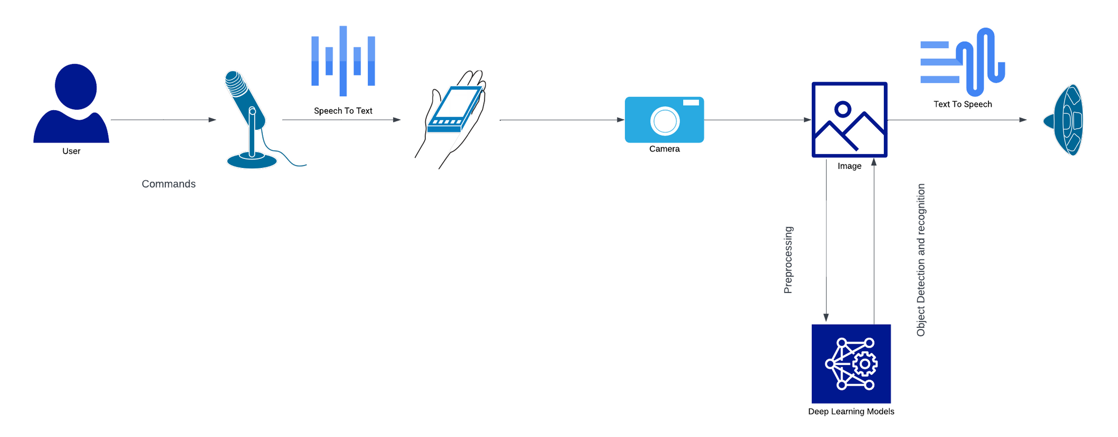
System Architecture

Slide 12
05
Dataset

Slide 13

Dataset
The dataset is MyNusringHome. It’s about 37,500 images.
It’s divided into 25 classes; each class contains 1,500 images.
Classes within the dataset include:
Basket Bin
Bed
Bench
Cabinet
Call Bell
Cane Stick
Chair
Wardrobe
Door
Electric Socket
Fan
Fire Extinguisher
Handrail
Human Being
Rack
Water dispenser
Refrigerator
Shower
Sink
Sofa
Table
Television
Toilet Seat
Wheelchair
Walker

Slide 14
06
Functionalities and Implementation Techniques

Slide 15
6.1
Functionalities
The user accesses the mobile application and registers his name in the SQL database using voice recognition.
The user can utilize the camera for object recognition to identify objects in his surroundings.
Moreover, the user can search for a specific object via the camera and receive feedback on whether it is located or not.
An extra feature permits the user to adjust the voice settings within the application.

Slide 16


6.2
Algorithms and Techniques
In preprocessing the dataset, we:
Exclude 2 out of 25 classes from the dataset, specifically those related to injured patients and uncommon indoor objects.
Resize images to (640 x 640) for uniformity.
Label images both automatically and manually to achieve high resolution.
Include bounding boxes for objects.
Adjust the format to be compatible with YOLOv8.

Slide 17
6.2
Algorithms and Techniques Cont.
We have employed various deep learning detection models like Faste R-CNN, SSD, MobileNet, EfficientNet, and YOLOv8. However, the accuracy and effectiveness of each model for object detection were not satisfactory. Consequently, we have opted to use YOLOv8 due to its superior accuracy and advantages.

Slide 18
6.2
Algorithms and Techniques Cont.
YOLO, short for You Only Look Once, is a widely-used object detection algorithm in the field of computer vision. It is renowned for its quick and effective object identification in both images and videos.
In contrast to traditional algorithms that necessitate multiple scans of an image, YOLO examines the entire image in a single pass through a convolutional neural network (CNN). This unique approach enables YOLO to perform real-time object detection, making it ideal for applications that demand rapid processing.

Slide 19

6.2
Algorithms and Techniques Cont.
We have applied a pre-trained YOLOv8 model on ImageNet, enabling us to engage in transfer learning with this well-established model. Through transfer learning, we can notably decrease the time and computational resources needed compared to training a model from the beginning.
Following model training and testing, we have created an application using Java and integrated the model as TFlite, ensuring it is lightweight and compatible with Android Studio.

Slide 20
6.3
YOLOv8 Model Architecture

Slide 21

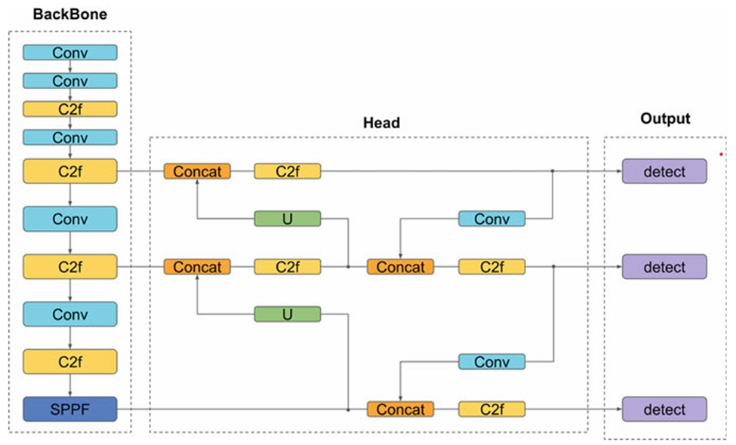

Slide 22
YOLO Model Implementation
6.4
Feature extraction: The CNN backbone extracts feature such as edges, corners, and textures from the image, which are used for object detection.
Object detection: The features extracted from the CNN backbone are used to essentially generate predictions for object classes and bounding box coordinates. YOLOv8 predicts bounding box coordinates in terms of the x, y, width, and height of the bounding box, demonstrating the features extracted from the CNN backbone and used to generate predictions for object classes and bounding box coordinates, which definitely is quite significant.

Slide 23
YOLO Model Implementation Cont.
6.4
Non-maximum suppression (NMS): After obtaining the predicted bounding box coordinates, YOLOv8 really uses non-maximum suppression (NMS) to essentially remove redundant detections. NMS compares the confidence scores of overlapping bounding boxes and generally keeps only the box with the highest confidence score of each object.

Slide 24
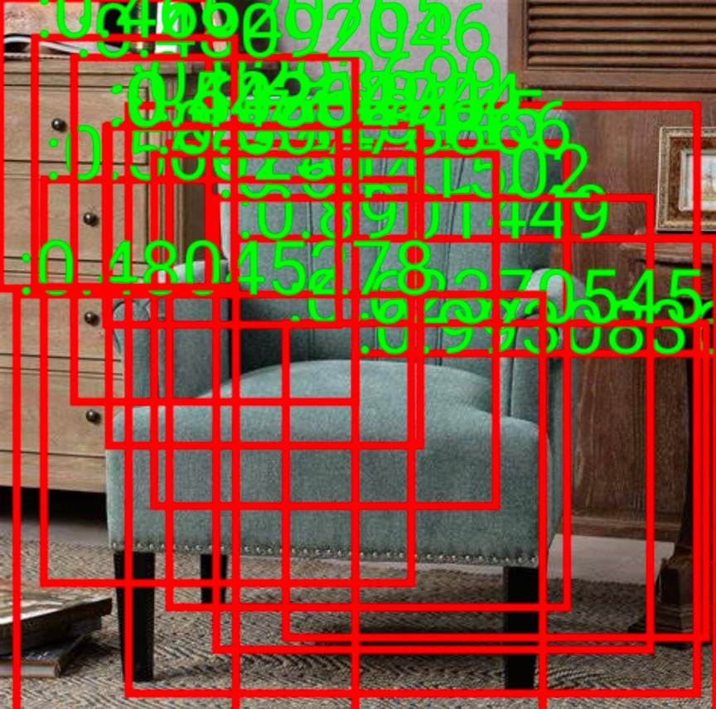
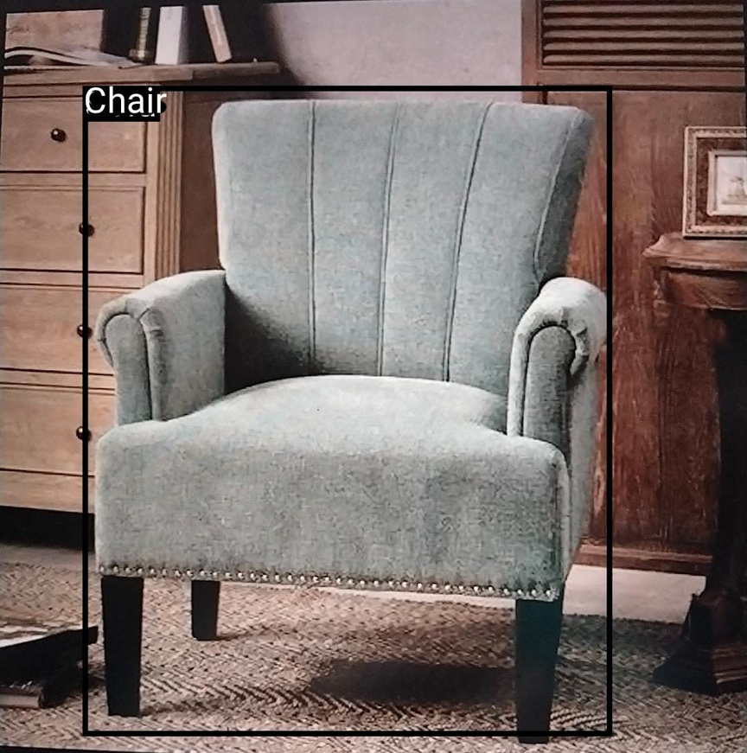
YOLO Model Implementation Cont.
6.4

Slide 25
07
Results and Run Application

Slide 26

Results
7.1
After 500 epoches:
MODEL | Accuracy for recognition | Loss for bounding box
YOLOv8 | 96% | 0.2
SSD | 90% | 0.3
Faster RCNN | 89% | 0.5
EfficientNet | 96% | -
MobileNet | 87% | -
We were keen to achieve high accuracy for VIP to ensure their safety.

Slide 27




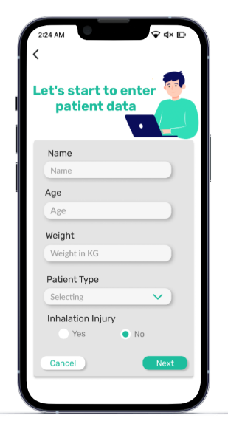
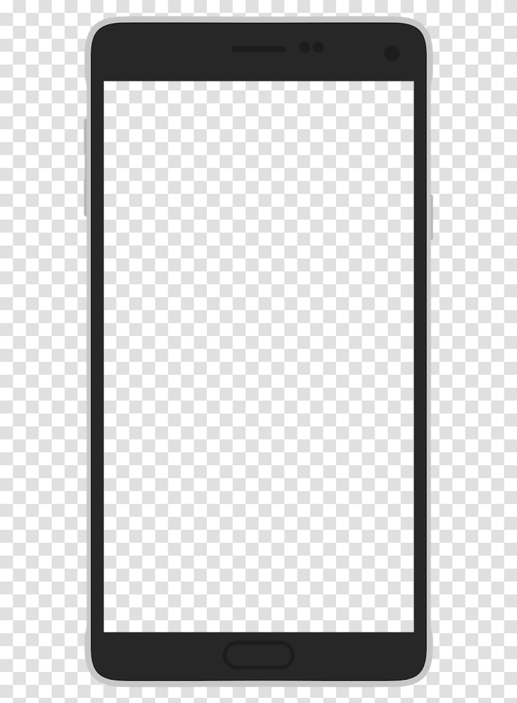
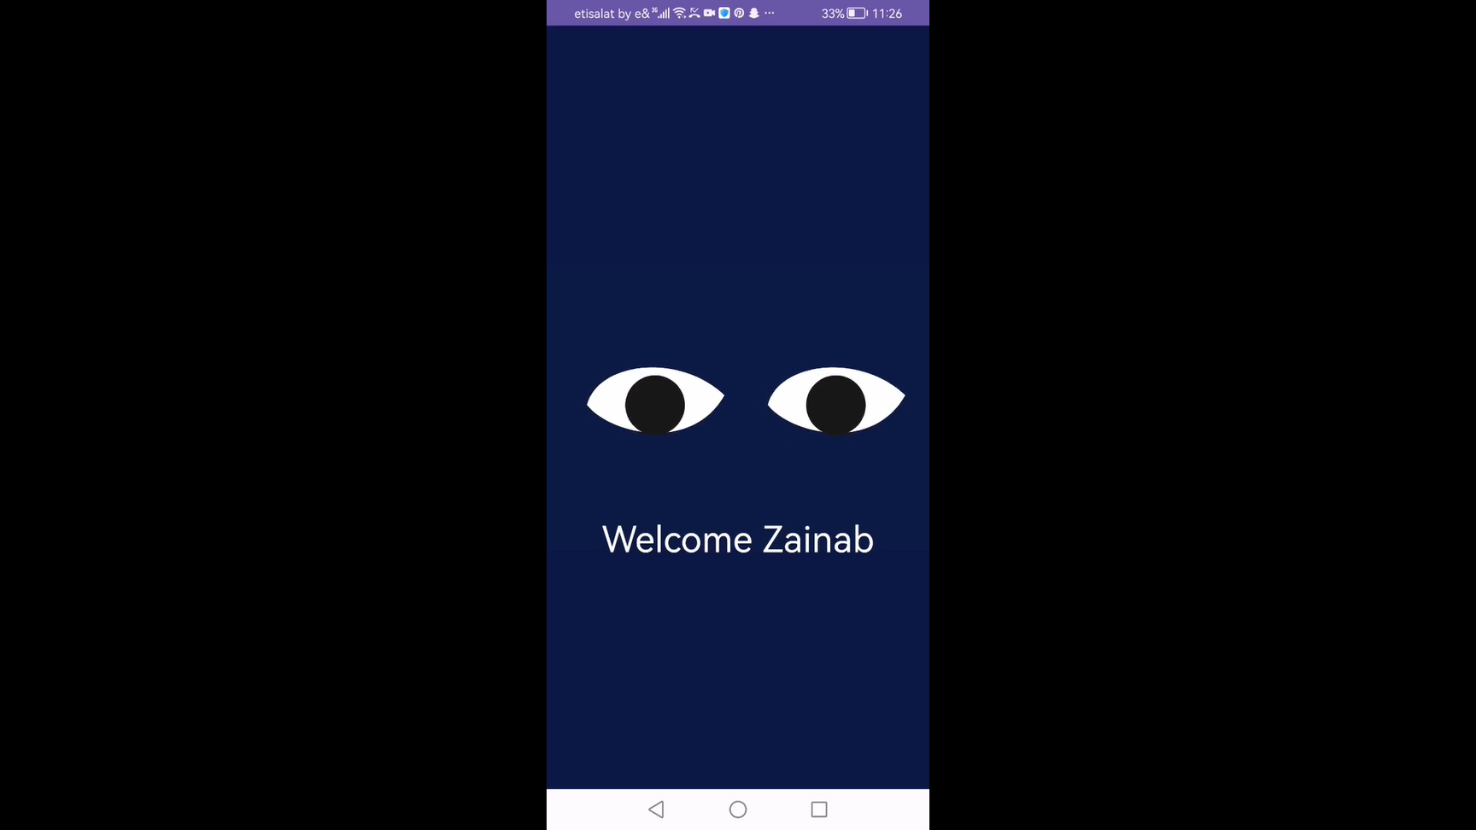
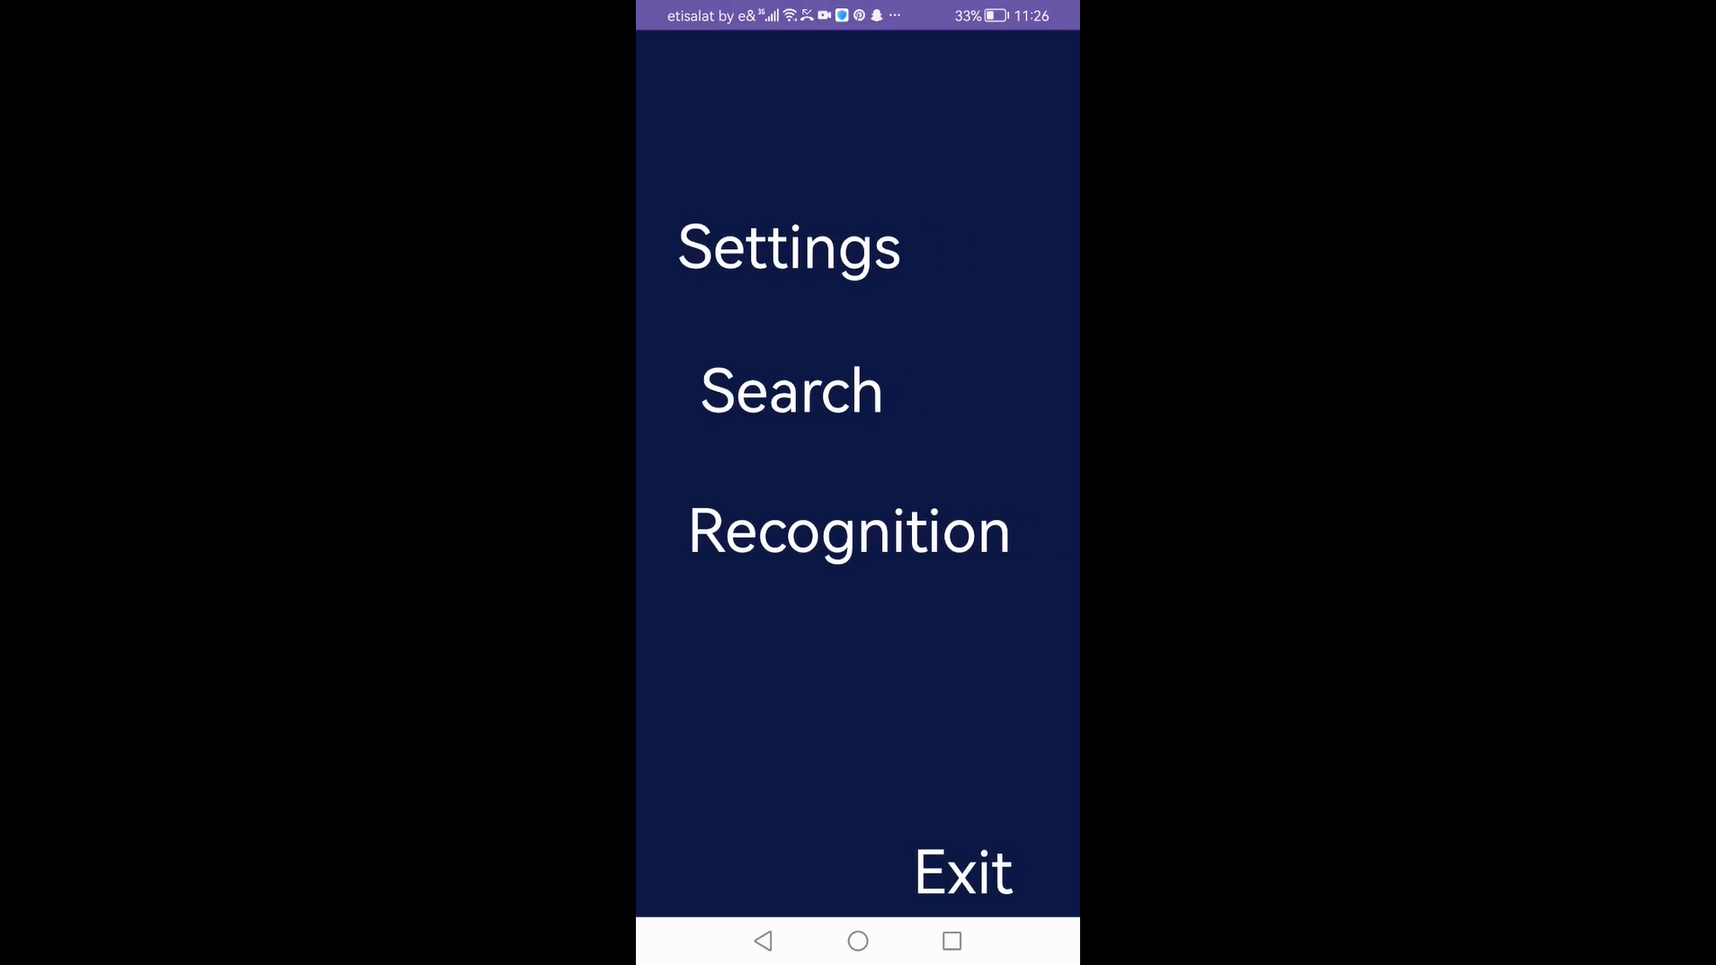
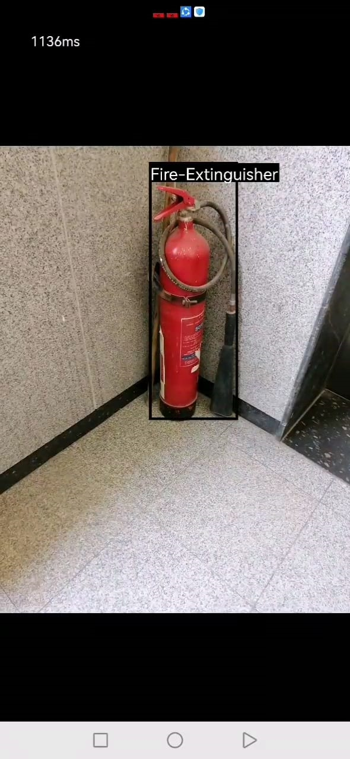
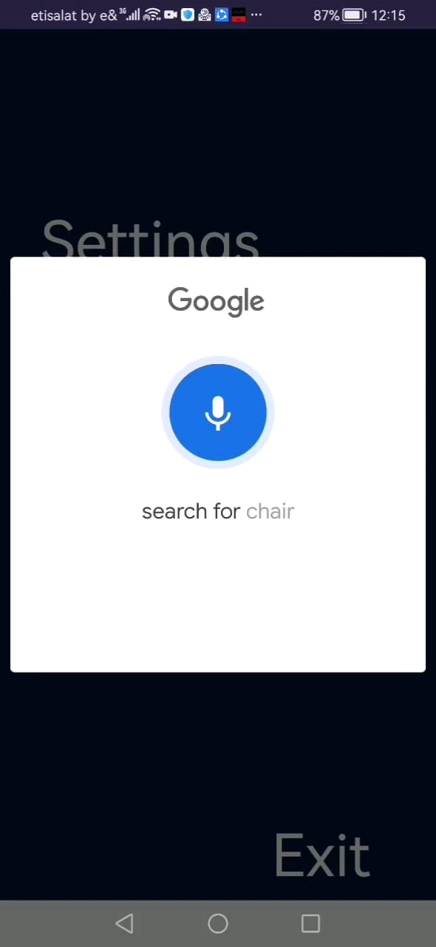
7.2
Run The Application

Slide 28
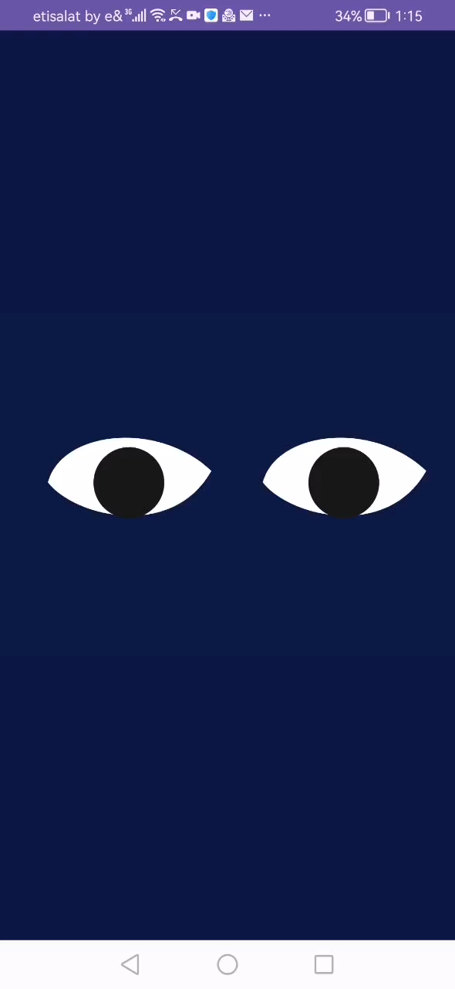
7.2
Run The Application

Slide 29
08
Conclusion and Future Work

Slide 30
8.1
Conclusion
Our project is focused on assisting visually impaired individuals in navigating their daily lives independently, without relying on others to describe scenes and objects to them.
By employing transfer learning, we have tested numerous detection models with varying accuracies.
Ultimately, we have implemented YOLOv8 with 96% accuracy in recognizing objects and 0.2 rate loss of bounding boxes for object detection.

Slide 31
8.1
Conclusion Cont.
We have created a user-friendly mobile application to simplify interactions for the visually impaired with voice assistance, providing accurate and detailed scene descriptions with high resolution to overcome obstacles.
Our belief is that technology should empower everyone, and our initiative is a stride towards a more inclusive and accessible world for the visually impaired community.

Slide 32
8.2
Future Work
The system determines the user's current room by recognizing objects present, such as a refrigerator, blender, sink, and knives, to identify it as a kitchen.
It alerts the user about obstacles that may block their path to reach specific objects.
Along with recognizing objects, the system can also measure the distance between the user and the desired object for efficient localization.

Slide 33
8.2
Future Work Cont.
Facial Recognition: The system can recognize individuals by using recognition technology, allowing the camera to identify them and check their presence in the database.
Support for Multiple Languages: The application can be extended to support various languages, such as Arabic, so users can access information in their preferred language.
Offline Voice Recognition: The system incorporates offline voice recognition, eliminating the need for Google's assistance in this feature.

Slide 34
8.3
Acknowledgement
We want to express our sincere gratitude to all the individuals who have been a great source of inspiration for us, guiding us to create a meaningful graduation project aimed at addressing a significant issue for VIPs.

Slide 35
Thank You For Listening

Slide 36


Any Questions?

